Slide 1
Citi Bike
Success Hangs in the Rebalance

Slide 2
Background
Citi Bike is the largest bike sharing program in the United States.
Citi Bike plans to continue their expansion to a service area of 35 square miles and a bike total around 40,000.
Citi Bike moves thousands of bikes daily to rebalance their stations and avoid stations with a surplus or shortage of bicycles.
Notes:
Valets,vans, bike angels

Slide 3
Research Question
How can City Bike manage its bicycle fleet to minimize empty or full docks during commuter surges?

Slide 4
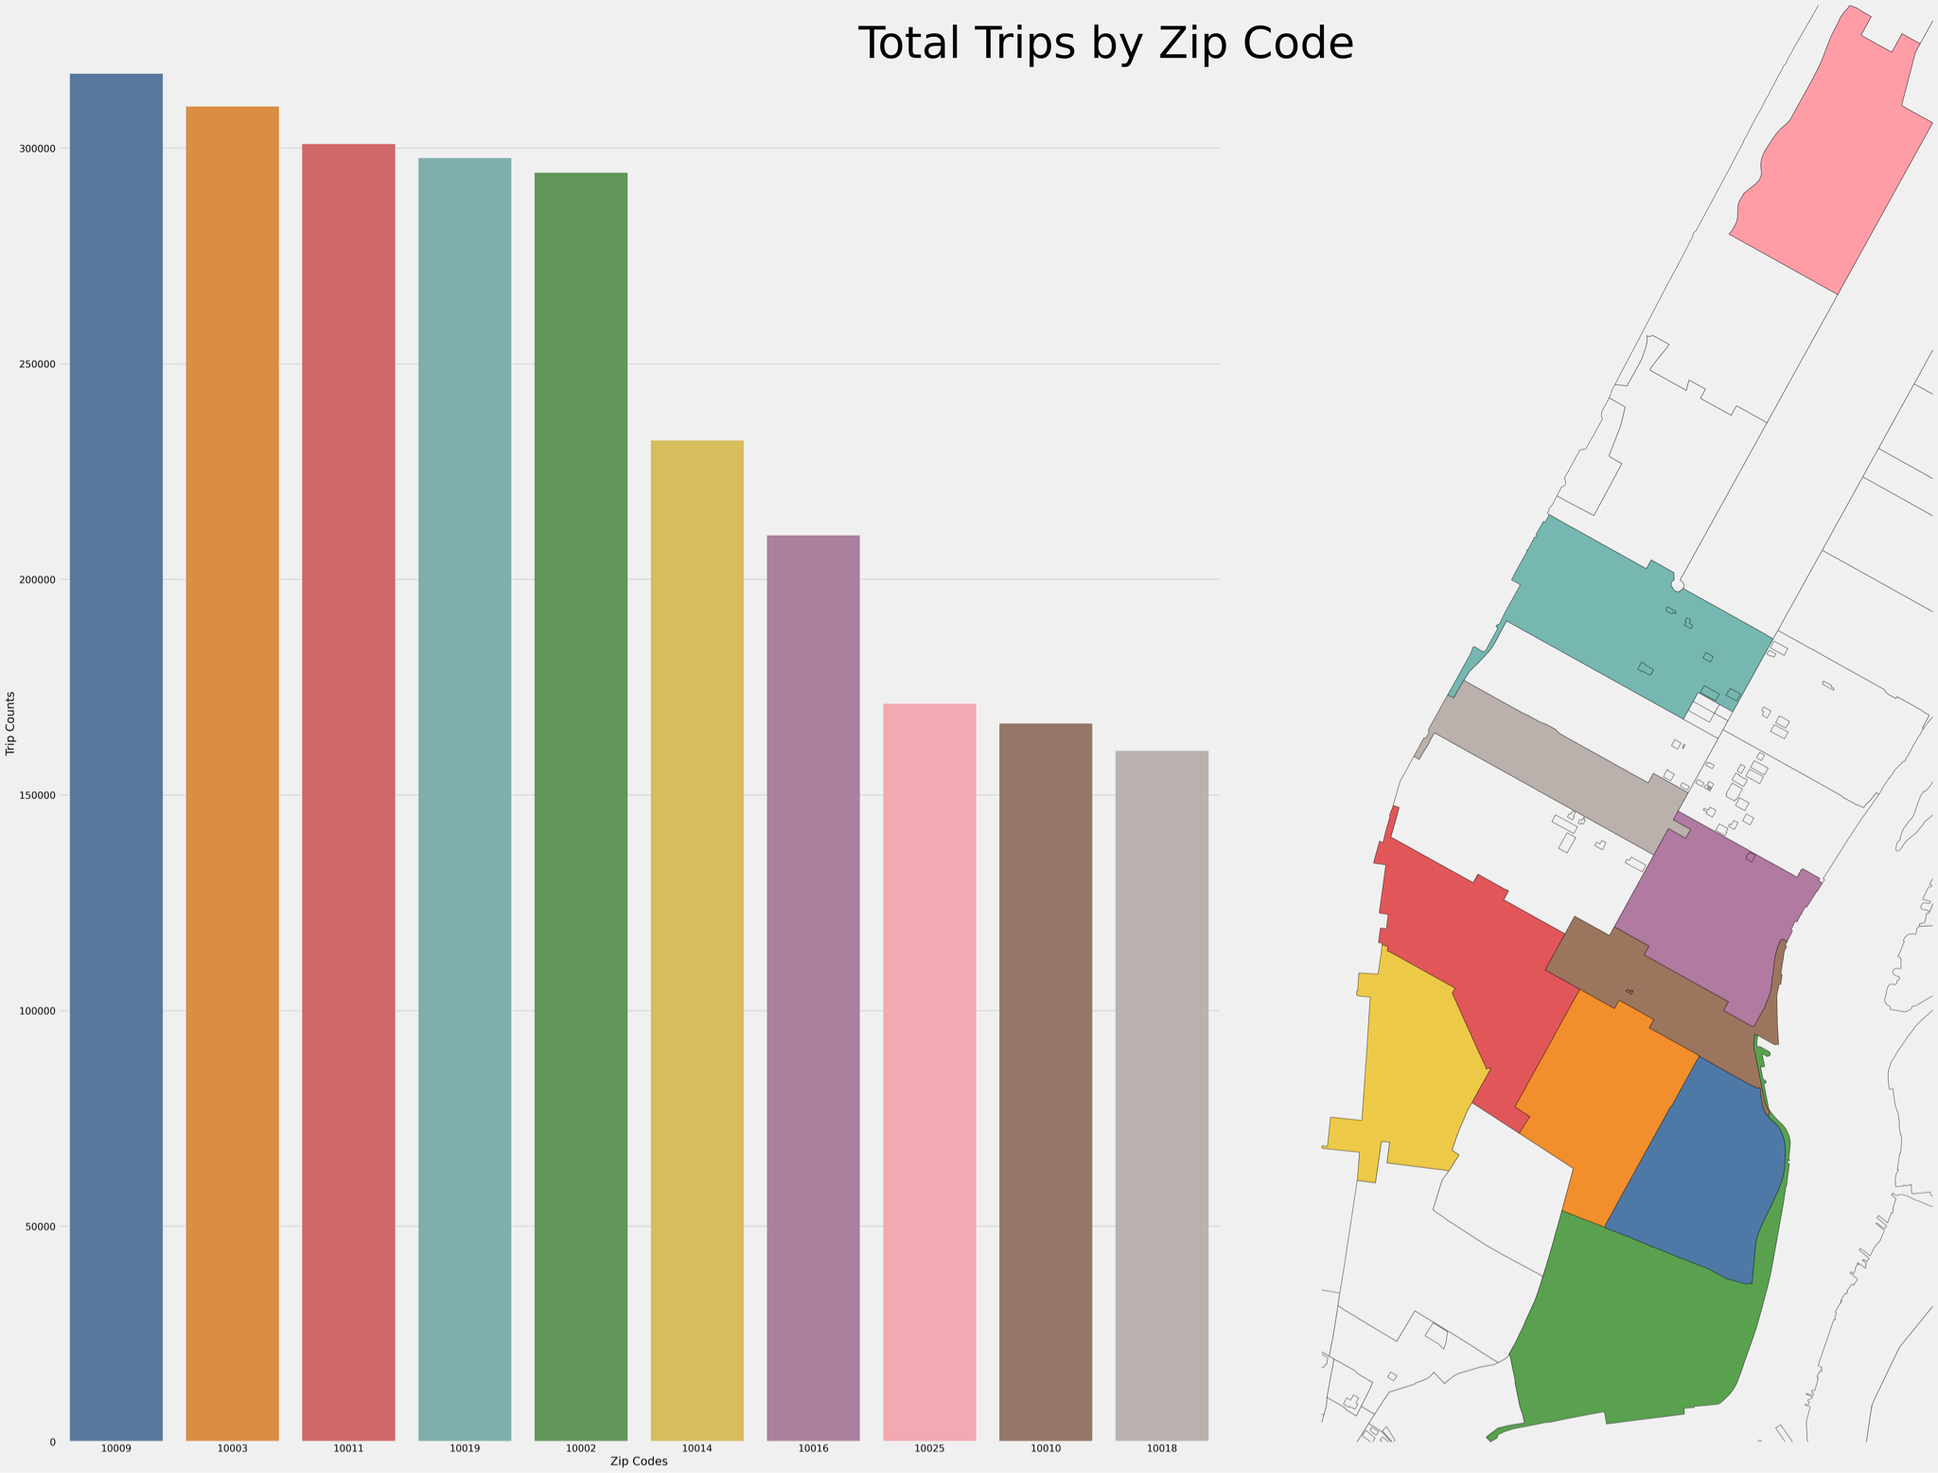

Slide 5
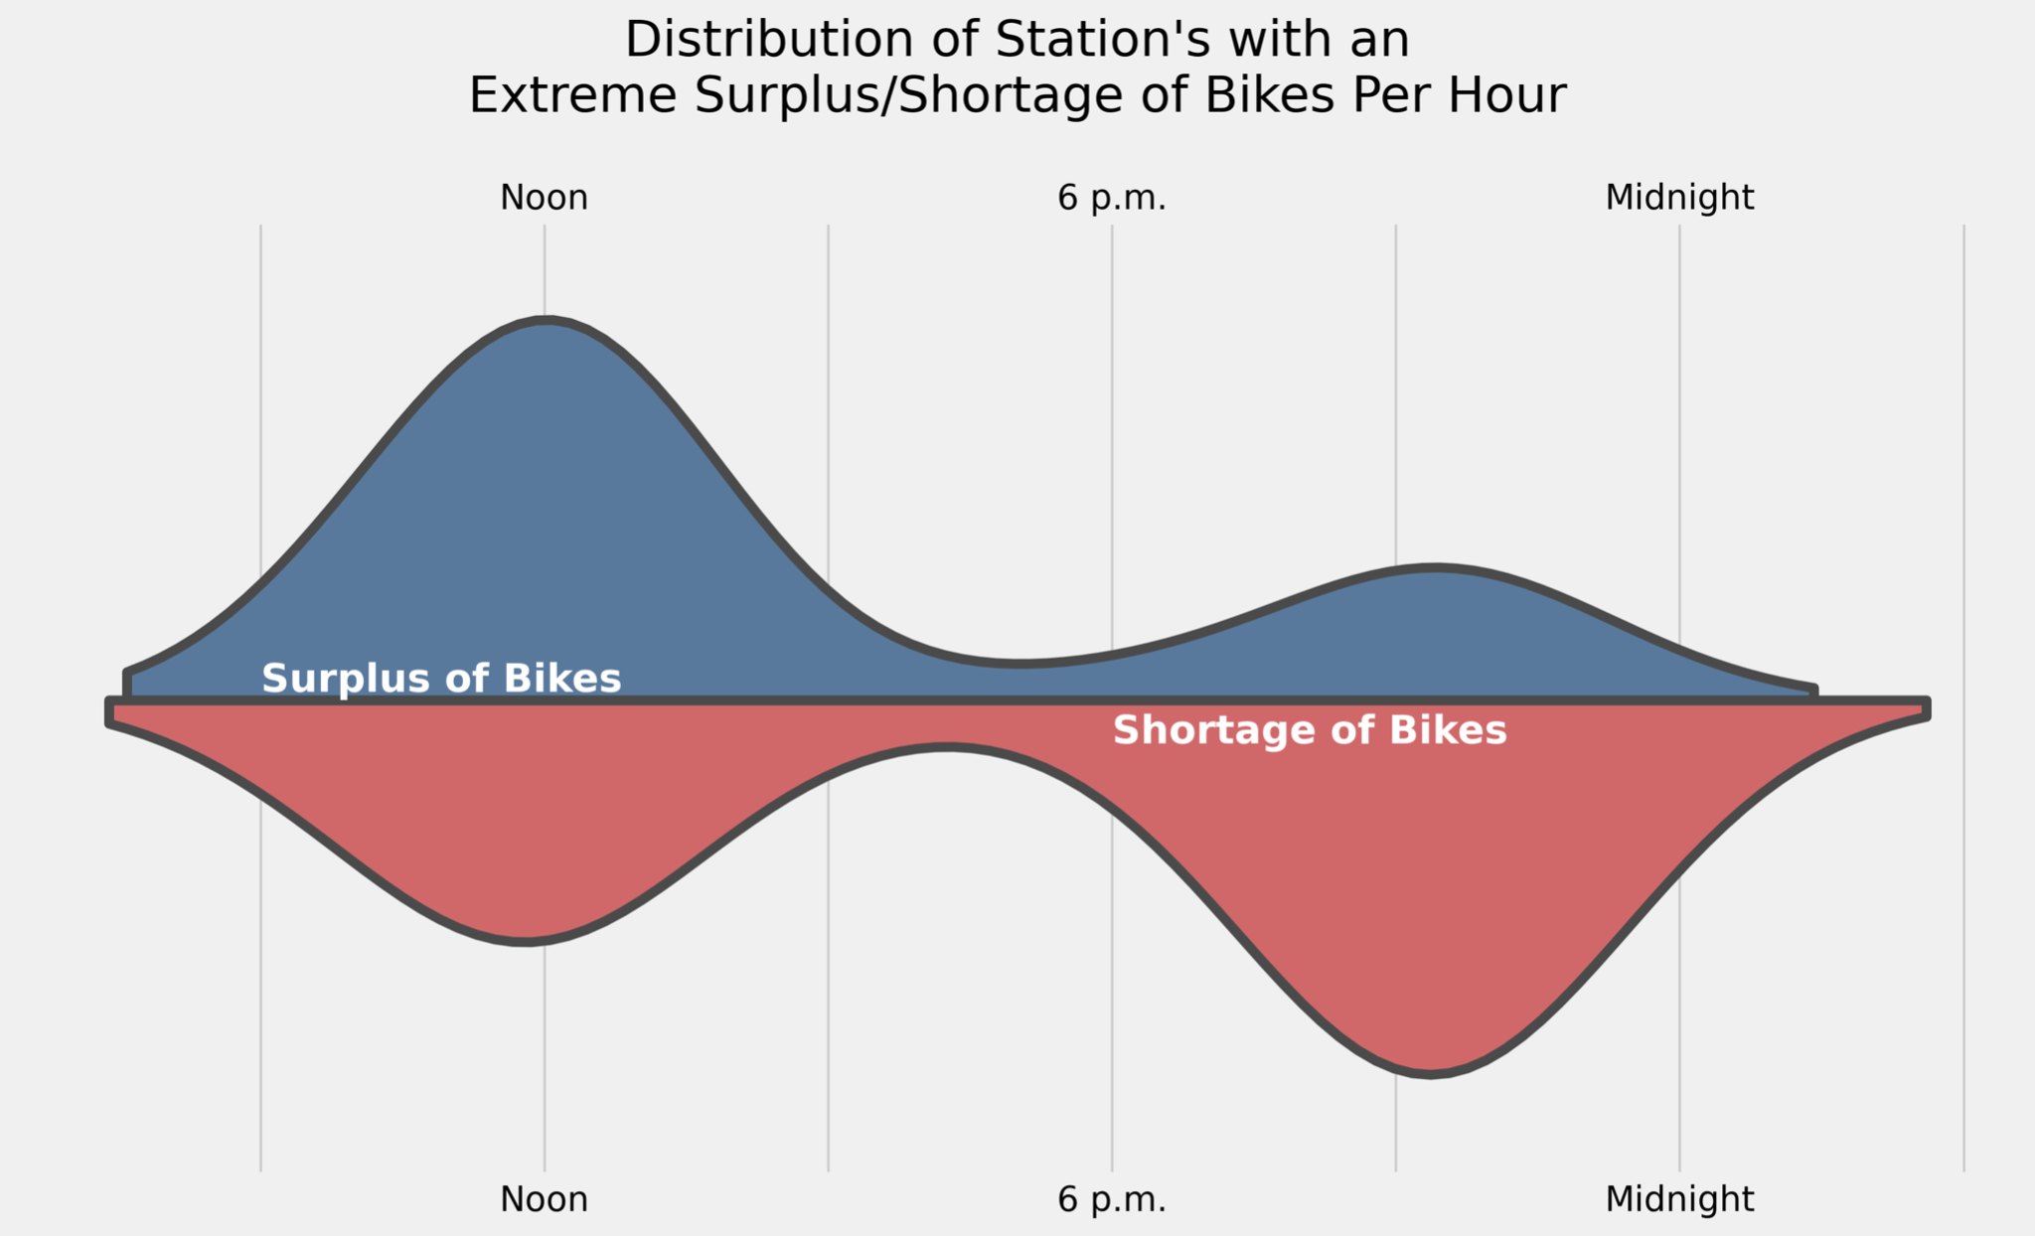
Extreme surplus/shortages of bikes are concentrated around Noon and 10 p.m.
Notes:
Extreme Surplus/Shortage at a Station is if there is a Surplus/Shortage greater than three, which is very rare see appendix

Slide 6
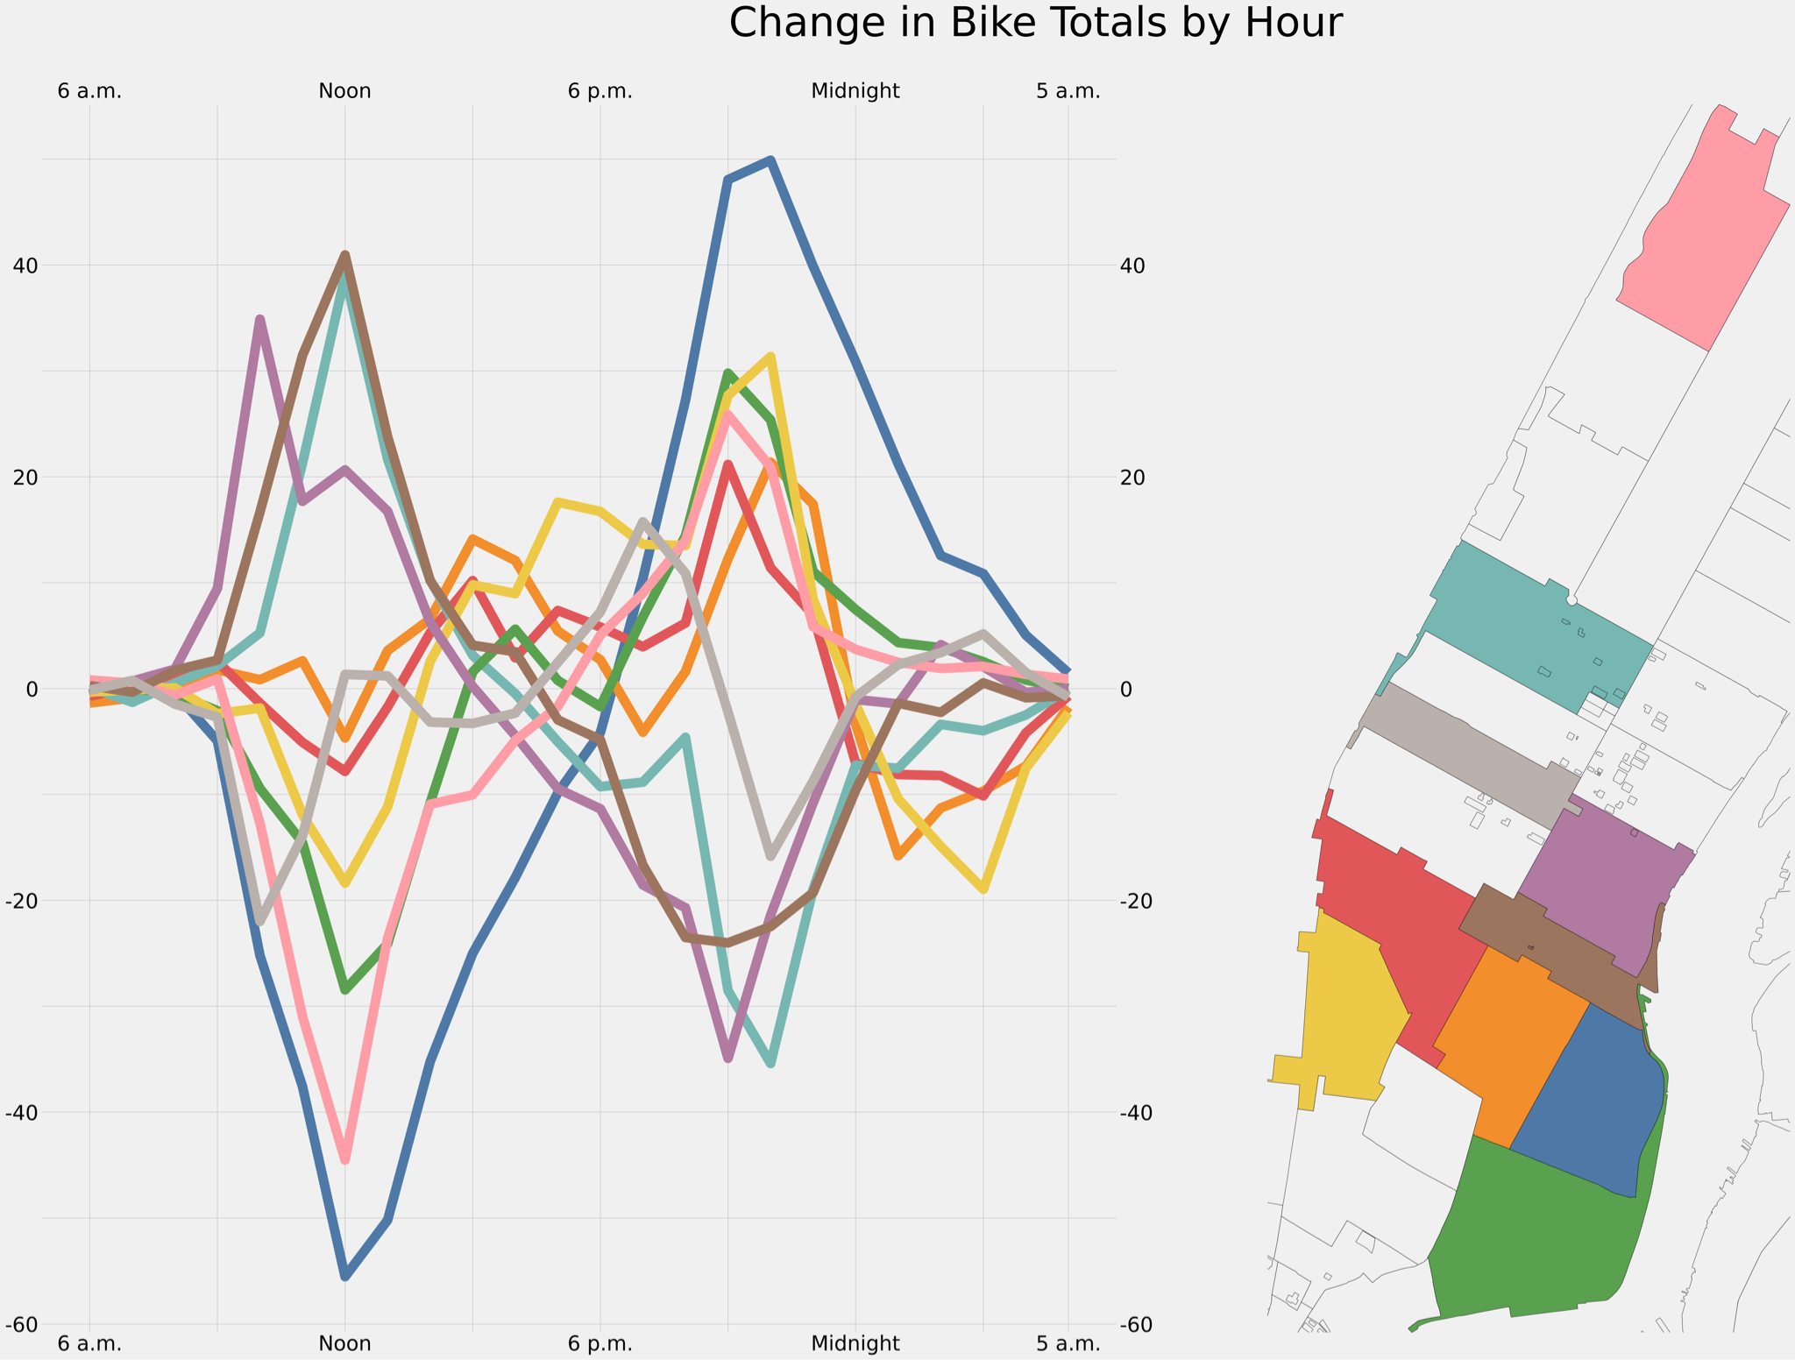
We can see people’s commute as people head to work around noon and then head home around 10 p.m.

Slide 7
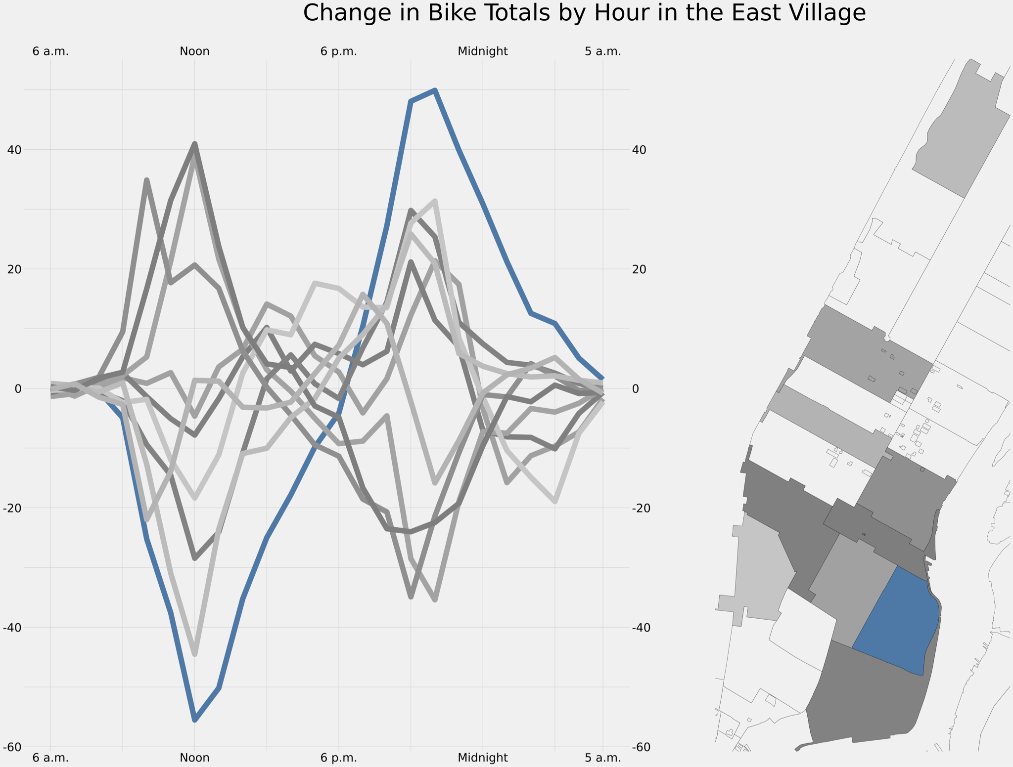
East Village has the most extreme migration patterns of any zip code.

Slide 8
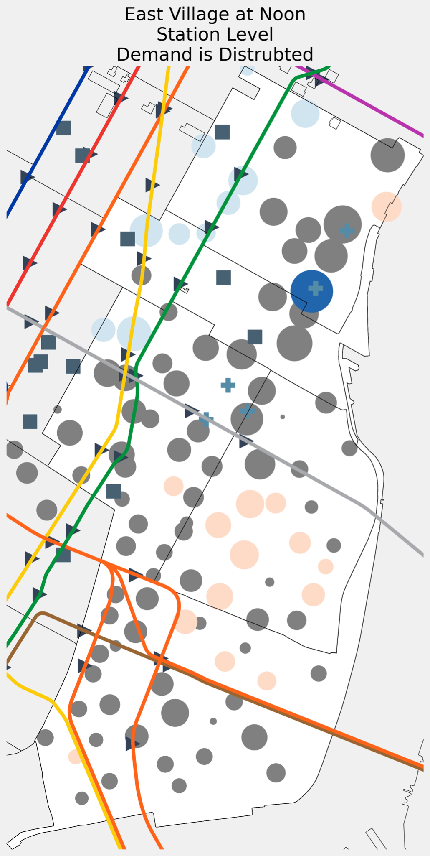
East Village @ Noon
East Village has a lot of bike leaving their stations
The demand is well dispersed.
Kips Bay has the most extreme change in bikes, near a hospital

Slide 9
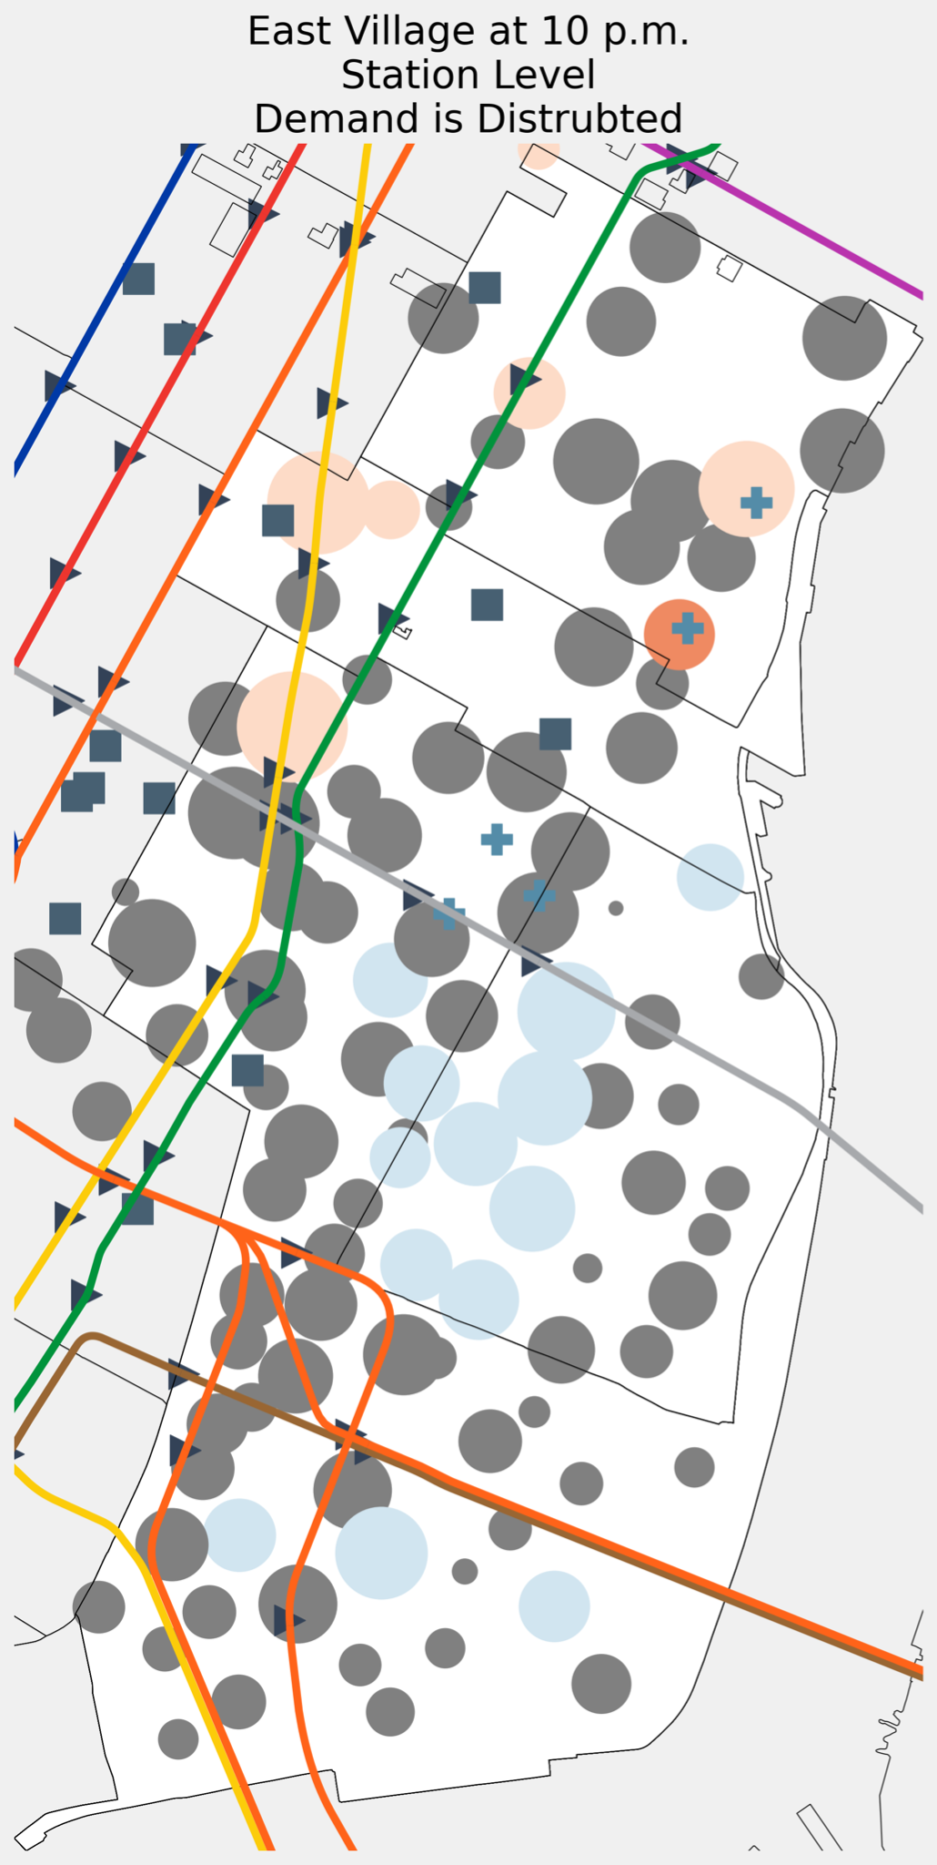
East Village @
10 p.m.
East Village has a lot of bike arriving at their stations
The demand is well dispersed.
Kips Bay has the most extreme change in bikes, near a hospital

Slide 10
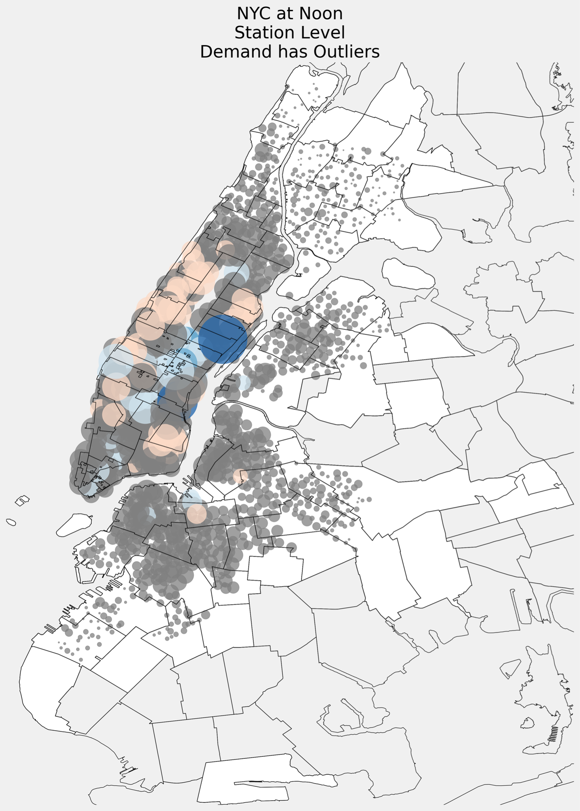

Slide 11
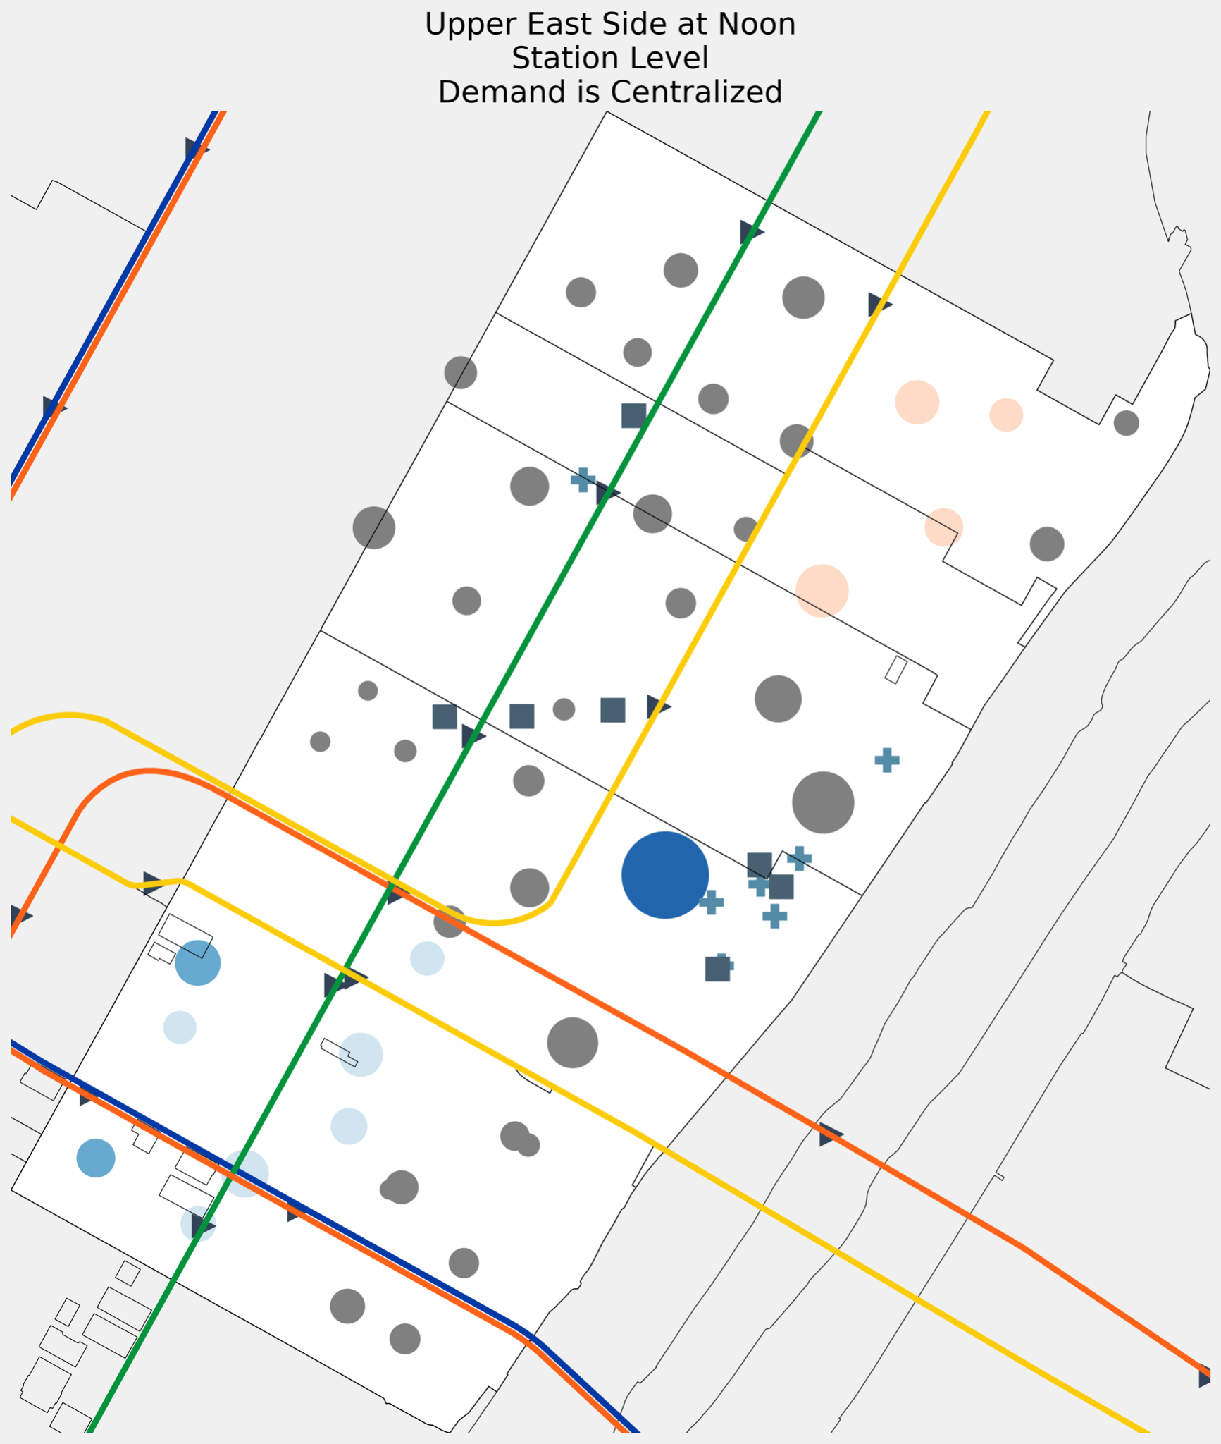
Upper East Side @
Noon
East Village has a lot of bike arriving at their stations
The demand is well concentrated, near a hospital.

Slide 12
Recommendations
Focus rebalancing efforts around noon and 10 p.m.
Have bike stations dispersed in high traffic areas.
Focus expansion around hospitals

Slide 13
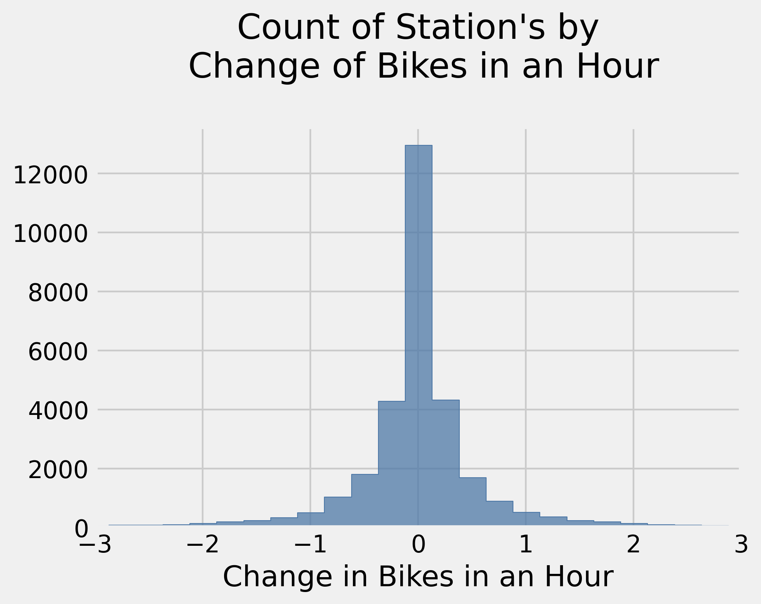
Appendix
Extreme changes in bikes at a given station are extremely rare.

